Slide 1
Structures and Strategies for State Space Search(2)
하 진 영
강원대학교 컴퓨터공학과

Slide 2
Implementing Graph Search
A problem solver
  must find a path from a start state to a goal through the state space graph
  sequence of arcs in this path ⇒ solution
Backtracking
  technique for systematically trying all paths
  backtracking search begins at the start state and pursues a path until it reaches either a goal or a “dead end”

Slide 3
Backtracking Search
Lists to keep track of nodes
  SL
    for state list,
    lists the states in the current path being tried. If a goal is found, SL contains the ordered list of states on the solution path
  NSL
    for new state list,
    contains nodes awaiting evaluation, i.e., nodes whose descendants have not yet been generated and searched.
  DE
    for dead ends,
    lists states whose descendants have failed to contain a goal node. If these states are encountered again, they will be detected as elements of DE and eliminated from consideration immediately.

Slide 4
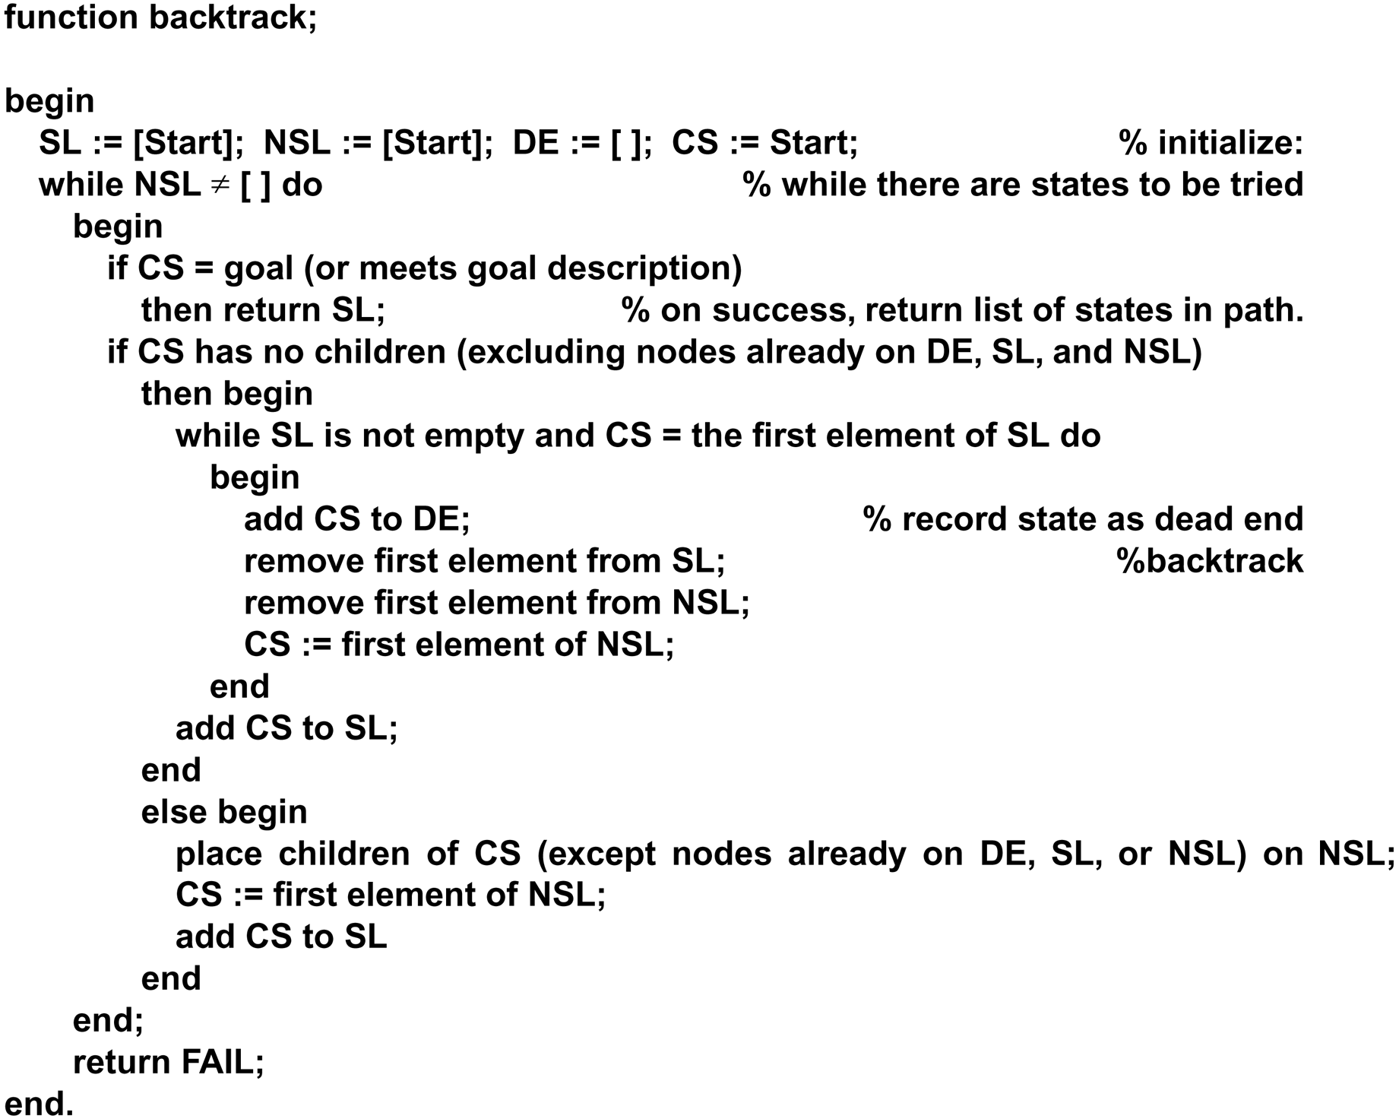

Slide 5
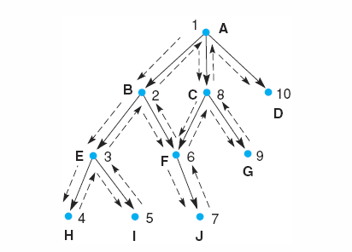
Depth-First Backtracking Search

Slide 6
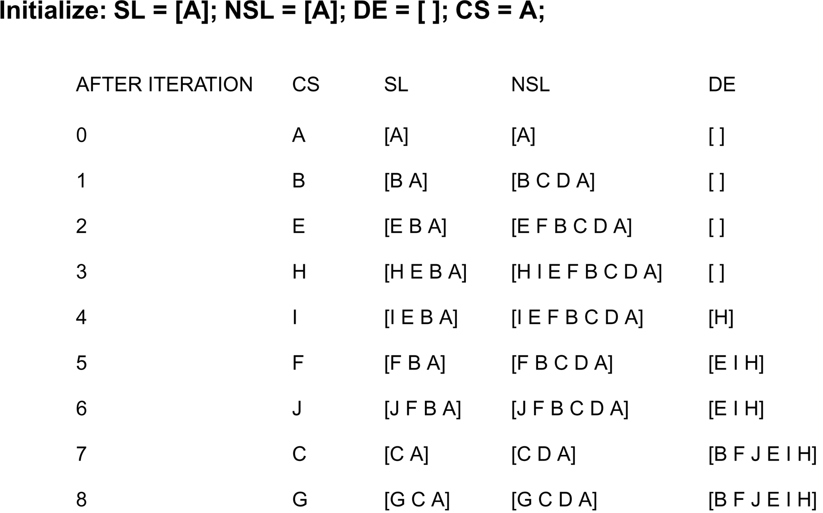
A Trace of backtrack

Slide 7
Backtrack
Backtrack
  implements data-driven search
    root: start state
    evaluating its children to search for the goal
Other search methods
  depth-first
  breadth-first
  best-first

Slide 8
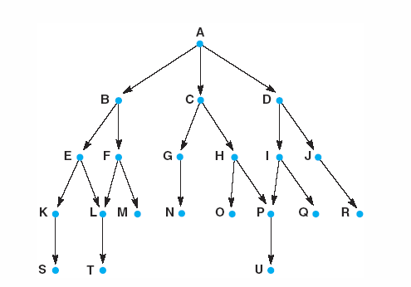
Graph for Search Example
Fig 3.15 Graph for breadth - and depth - first search examples.

Slide 9
Depth-First Search
When a state is examined
  all of its children and their descendants are examined before any of its sibling
Depth-first search examines the states in the order
  A,B,E,K,S,L,T,F,M,C,G,N,H,O,P,U,D,I,Q,J,R
The backtrack algorithm implemented depth-first search

Slide 10
Breadth-First Search
Explores the space in a level-by-level fashion
Breadth-first search examines the states in the order
  A,B,C,D,E,F,G,H,I,J,K,L,M,N,O,P,Q,R,S,T,U
Lists
  open
    like NSL in backtrack, lists states that have been generated but whose children have not been examined
    the order in which states are removed from open determines the order of the search
  closed
    records states that have already been examined
    union of the DE and SL lists of the backtrack algorithm

Slide 11
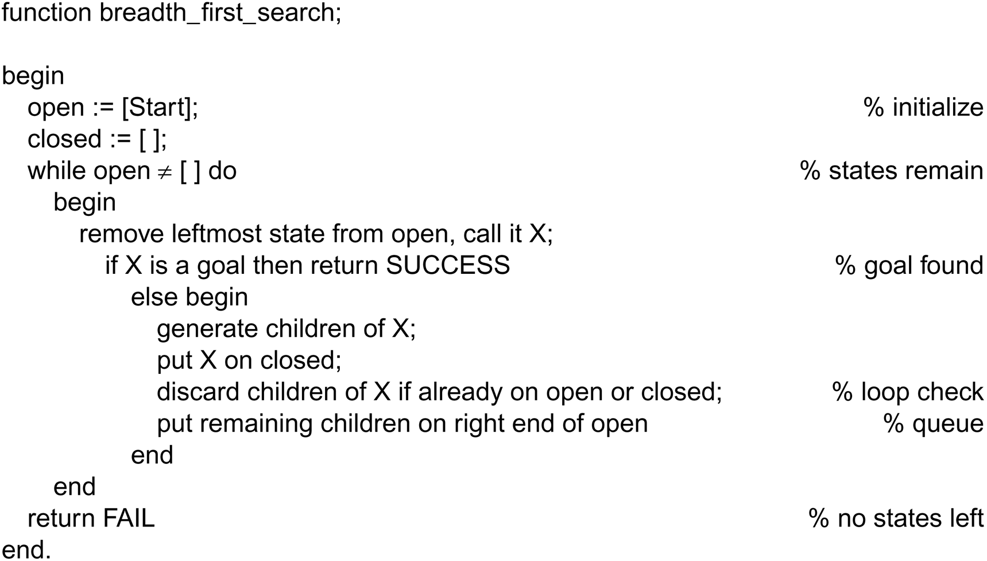

Slide 12
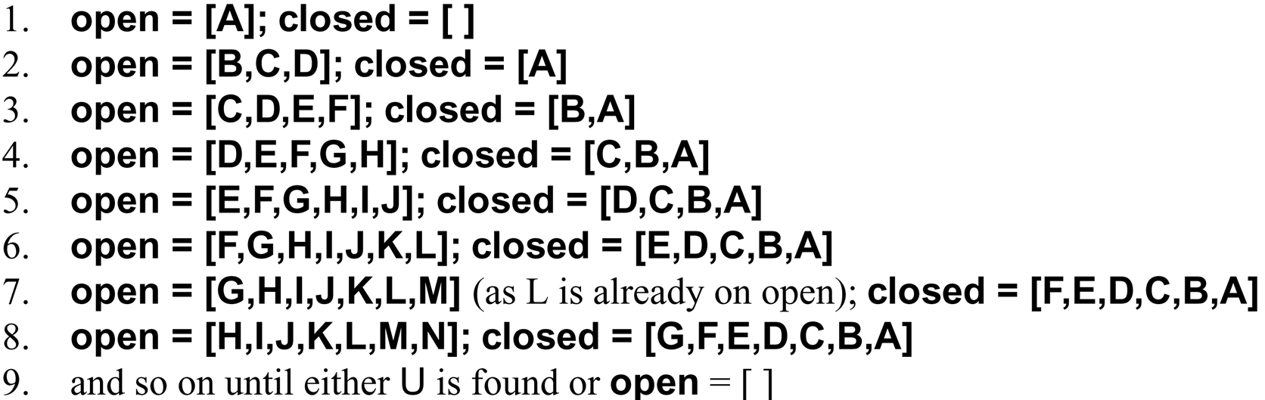
A Trace of breadth_first_search
A trace of breadth_first_search on the graph of Figure 3.15

Slide 13
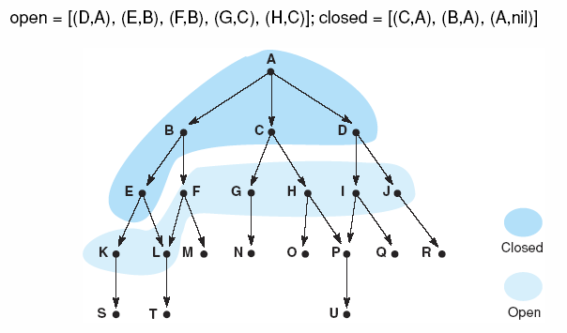
Graph at Iteration 6 of Breadth-First Search
Fig 3.16 Graph of Fig 3.15 at iteration 6 of breadth-first search. States on open and closed are highlighted.

Slide 14
Tracing Back Information
It is often useful to keep other information on open and closed besides the name of the states
  breadth_first_search does not maintain a list of states on the current path to a goal as backtrack did on the list SL; all visited states are kept on closed
By storing ancestor information
  ordered pair (state, parent) at the fourth iteration
    open = [(D,A),(E,B),(F,B),(G,C),(H,C)]
    closed = [(C,A),(B,A),(A,nil)]
  path to a goal can be constructed

Slide 15
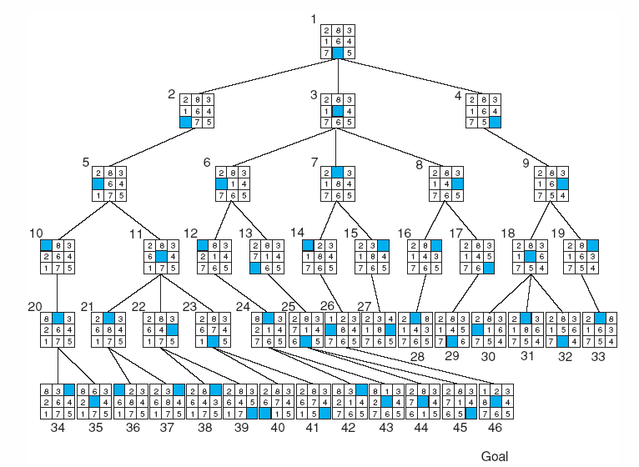
Fig 3.17 Breadth-first search of the 8-puzzle, showing order in which states were removed from open.

Slide 16
Breadth-First Search v.s. Depth-First Search
Breadth-first search
  guaranteed to find the shortest path from the start state to the goal
Depth-first search
  not guaranteed to find the shortest path to a state the first time that state is encountered
  can be created by modifying breadth-first search algorithm
    queue → stack

Slide 17
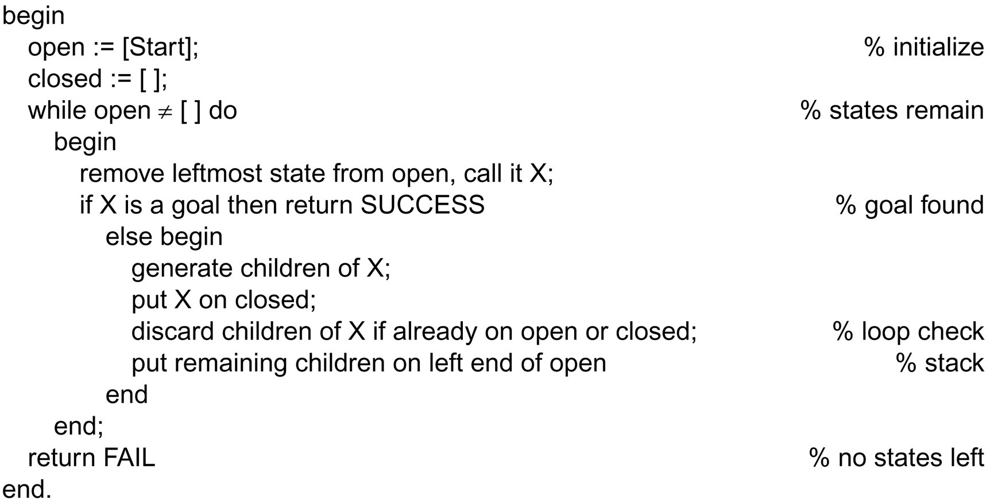
Function depth_first_search algorithm

Slide 18
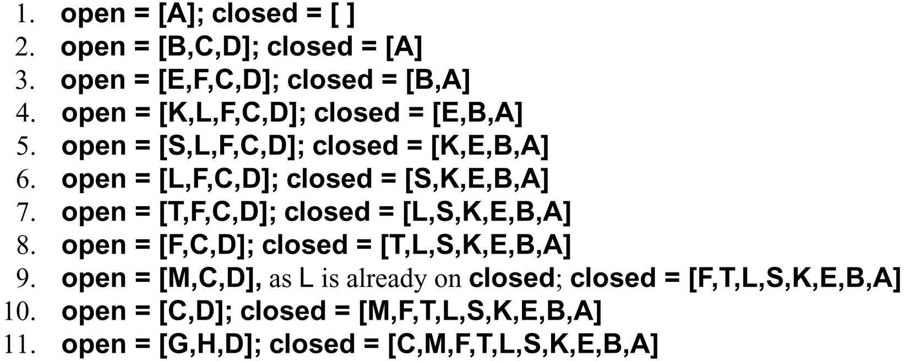
A Trace of depth_first_search
A trace of depth_first_search on the graph of Figure 3.15

Slide 19
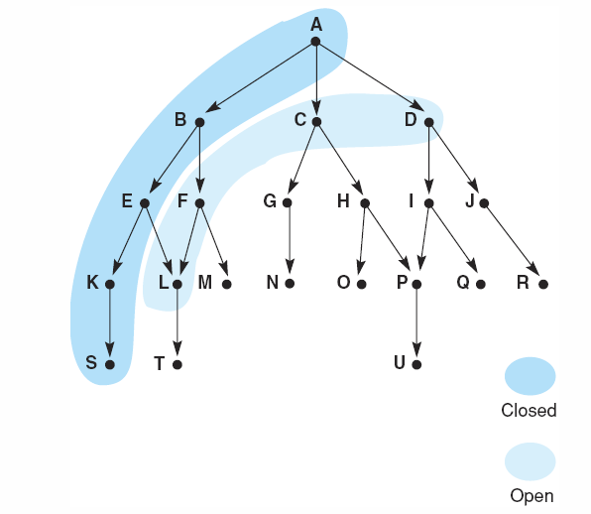
Fig 3.18 Graph of fig 3.15 at iteration 6 of depth-first search. States on open and closed are highlighted.

Slide 20
Discussions
Breadth-first search
  always finds the shortest path, since it examines all the nodes at level n before proceeding to level n+1
  If there is a bad branching factor, the combinatorics may prevent the algorithm from finding a solution using the available space.
  The space utilization measured in terms of the number of states on open, is an exponential function of the length of the path at any time or B^{n} states on level n.

Slide 21
Discussions (2)
Depth-first search
  gets quickly into a deep search space
  If it is known that the solution path will be long, depth-first search will not waste time searching a large number of “shallow” states in the graph.
  can get “lost” deep in a graph, missing shorter paths to a goal
  much more efficient for search space with many branches because it does not have to keep all the nodes at a given level on the open list
  the space usage is a linear function of the length of the path (B × n)

Slide 22
Discussion (3)
Depth-first iterative deepening
  performs a depth-first search of the space with a depth bound of one
  If it fails to find a goal, it performs another depth-first search with depth bound of two. We increase the depth bound by one each time.
  At each iteration, the algorithm performs a complete depth-first search to the current depth bound. No information about the state space is retained between iterations.
  Since the algorithm searches the space in a level-by-level-fashion, it is guaranteed to find a shortest path to a goal.
  Since it does only depth-first search at each iteration, the space usage at any level n is B times n, where B is the average number of children of a node.

Slide 23
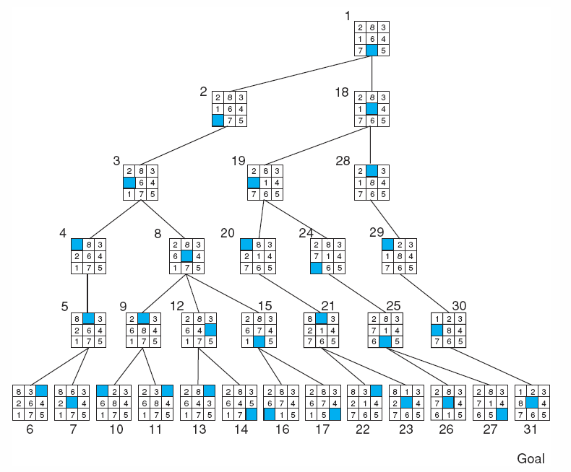
Fig 3.19 Depth-first search of the 8-puzzle with a depth bound of 5.

Slide 24
Discussion (4)
All the search strategies discussed
  worst-case exponential time complexity
    true for all uninformed search algorithm
  employ heuristics to reduce the complexity
Best-first search (Chapter 4)
  similar to the algorithms for depth- and breadth-first search
  orders the states on the open list according to some measure of their heuristic merit
  at each iteration, it considers neither the deepest nor the shallowest but the “best” state

Slide 25
State Space Description of a Logical System
Nodes
  distinguished by using predicate calculus as the formal specification language
Arcs
  created and described by inference rules
Search
  determines whether a particular expression is a logical consequence of a given set of assertions
Power and generality of logical representation
  allow most AI problem solving to use predicate calculus descriptions and inference rules

Slide 26
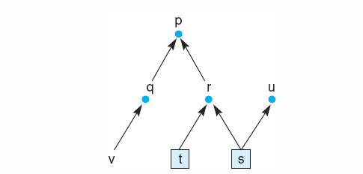
Propositional Calculus Example
Assume the following set of assertions:
  q → p, r → p, v → q, s → r, t → r, s → u, s, t
From the set of assertion and the inference rule modus ponens
  p, r, and u: propositions may be inferred
  v and q : propositions may not be so inferred

Slide 27
Propositional Calculus Example(2)
State space graph
  arcs correspond to logical implication(→)
  propositions that are given as true (s and t) correspond to the given data of the problem
  propositions that are logical consequences of this set of assertions correspond to the nodes that may be reached along a directed path from a state representing a true proposition
  the path [s,r,p] corresponds to the sequence of inferences:
    s and s → r yields r.
    r and r → p yields p.

Slide 28
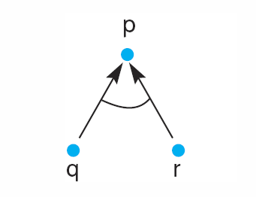
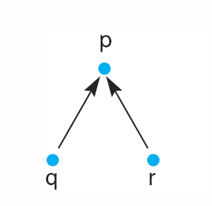
And / Or Graphs
Important tool for describing the search spaces generated by many AI problems
  those solved by logical theorem provers
  expert systems
Expressions of the form
  q ∧ r → p
    both q and r must be true for p to be true
  q ∨ r → p
    q → p, r → p
Graphical representation
  and nodes and or nodes

Slide 29
Definition
Hypergraph
  A hypergraph consists of:
    N, a set of nodes
    H, a set of hyperarcs defined by ordered pairs in which the first element of the pair is a single node from N and the second element is a subset of N.
    An ordinary graph is a special case of hypergraph in which all the sets of descendant nodes have a cardinality of 1.

Slide 30
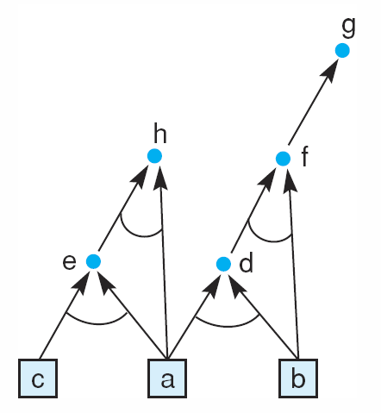
Example: And/Or Graph
a
b
c
a ∧ b → d
a ∧ c → e
b ∧ d → f
f → g
a ∧ e → h
Propositions
And/or graph of a set of
propositional calculus expressions

Slide 31
Example: And/Or Graph (2)
Questions that might be asked are:
  Is h true?
  Is h true if b is no longer true?
  What is the shortest path to show that X is true?
  Show that the proposition p is false. What does this mean? What would be necessary to achieve this conclusion?

Slide 32
Further Examples and Applications
MACSYMA
  well-known program that is used extensively by mathematicians
  reasoning can be represented as an and/or graph

Slide 33
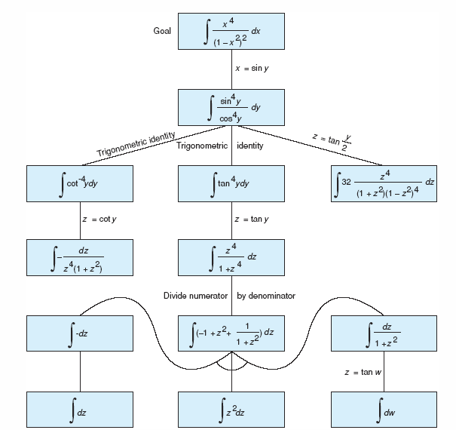
Fig 3.24 And/or graph of part of the state space for integrating a function, from Nilsson (1971).

Slide 34
Example: Predicate Calculus
This example
  is taken from the predicate calculus and
  represents a goal-driven graph search
  facts and rules
    Fred is a collie. collie(fred).
    Sam is Fred’s master. master(fred,sam).
    It is Saturday. day(saturday).
    It is cold on Saturday. ¬ (warm(saturday)).
    Fred is a trained dog. trained(fred).
    Spaniels or collies that are trained are good dogs. ∀X[spaniel(X)∨(collie(X)∧trained(X))⇒gooddog(X)].
    If a dog is a good dog and has a master then he will be with his master. ∀(X,Y,Z)[gooddog(X) ∧master(X,Y) ∧location(Y,Z) ⇒ location(X,Z)].
    If it is Saturday and warm, then Sam is at the park. day(saturday) ∧warm(saturday) ⇒location(sam,park).
    If it is Saturday and not warm, then Sam is at the museum. day(saturday) ∧ ¬ (warm(saturday)) ⇒location(sam,museum).

Slide 35
Example: Predicate Calculus(2)
Goal: “Where is Fred?”
  ∃X location(fred,X)
Solution
  goal-driven search
    using the predicate calculus
  role of unification in the generation of the search space

Slide 36
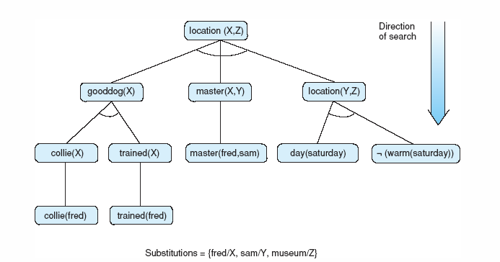
Fig 3.25 The solution subgraph showing that Fred is at the museum.

Slide 37
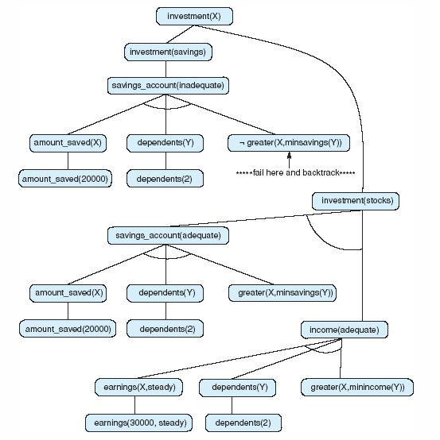
Fig 3.26 And/or graph searched by the financial advisor.

Slide 38
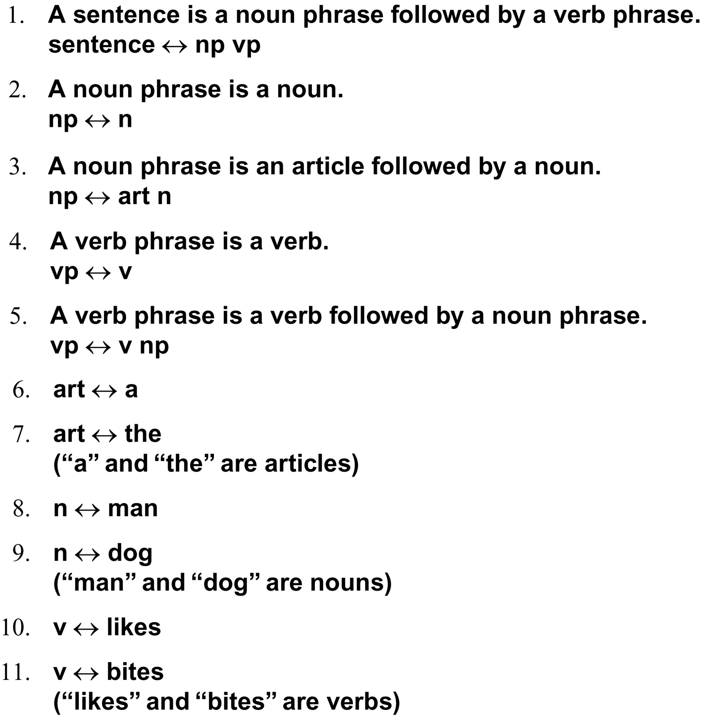
Five rules for a simple subset of English grammar are:

Slide 39
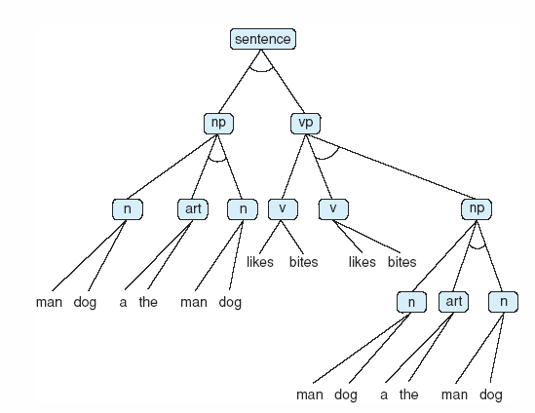
Fig 3.27 And/or graph for the grammar of Example 3.3.6. Some of the nodes (np, art, etc) have been written more than once to simplify drawing the graph.

Slide 40
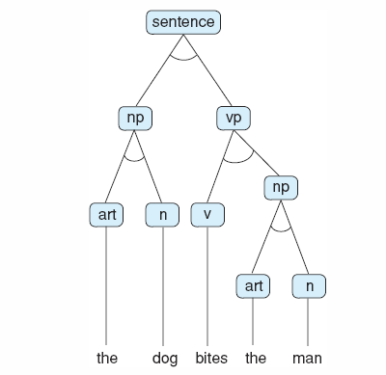
Fig 3.28 Parse tree for the sentence “The dog bites the man.” Note this is a subtree of the graph of fig 3.27.

